Slide 1
ADVENTURE WORKS
Adventure Works Cycles, the company on which the Adventure Works sample databases are based, is a large, multinational manufacturing company. The company manufactures and sells metal and composite bicycles to North American, European and Asian commercial markets. While its base operation is in Bothell, Washington with 290 employees, several regional sales teams are located throughout their market base.
In 2000s, Adventure Works Cycles bought a small manufacturing plant in Mexico. Which manufactures several critical subcomponents for the Adventure Works Cycles product line. These subcomponents are shipped to the Bothell location for final product assembly. In 2001, this manufacturing plant became the sole manufacturer and distributor of the touring bicycle product group.
Coming off a successful fiscal year, Adventure Works Cycles is looking to broaden its market share by targeting their sales to their best customers, extending their product availability through an external Web site, and reducing their cost of sales through lower production costs.

Slide 2
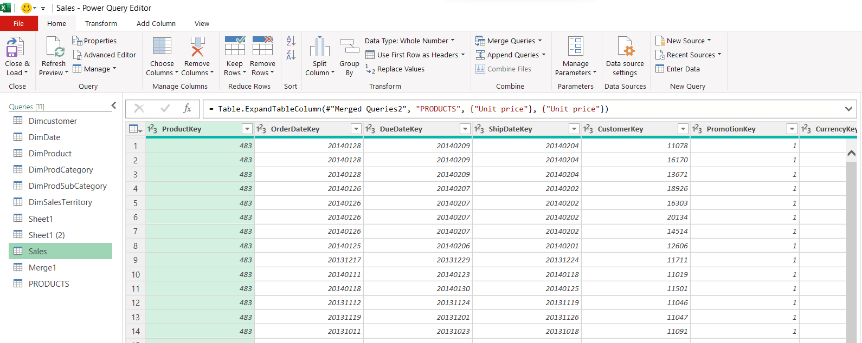
I . Append/Union of Fact Internet sales and Fact internet sales new - SALES
Sales table created-Append/Union FactInternetSale + Fact_Internet_Sales_New → SALES Table

Slide 3
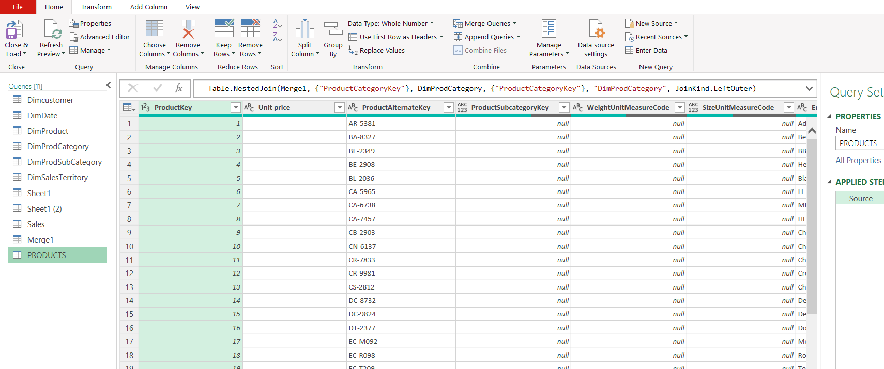
II. Merge Products, ProductCategory and ProductSubCategory Tables
PRODUCT Table created after merge

Slide 4
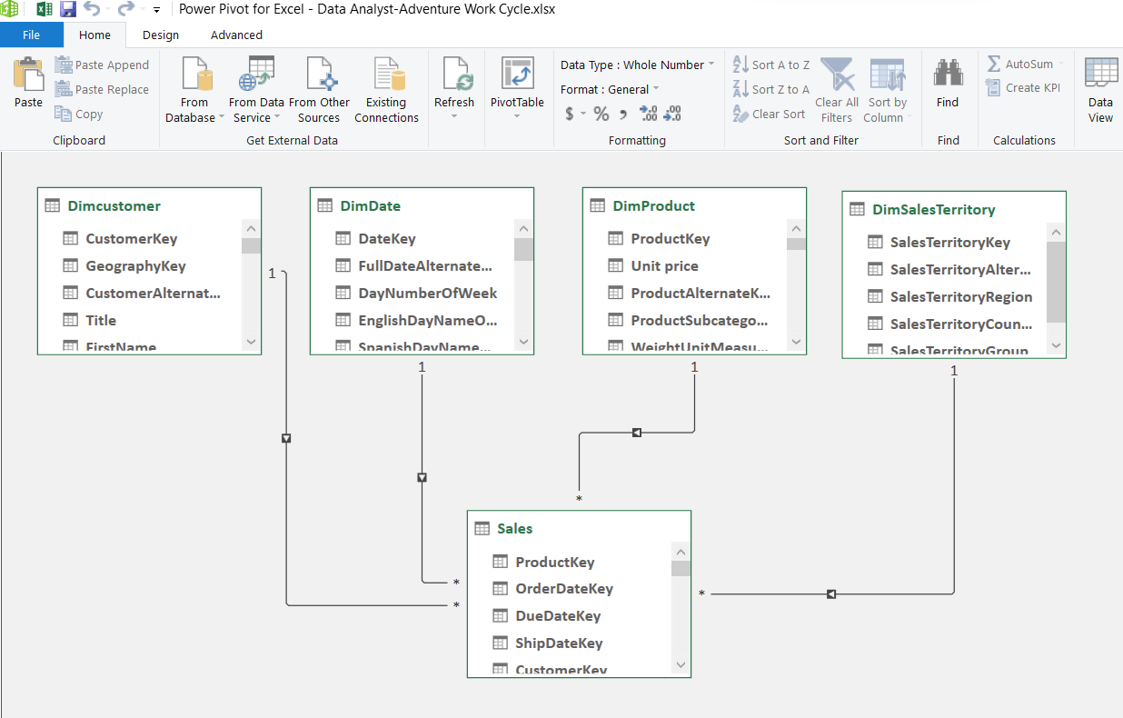
III. Create Relationships between Tables

Slide 5
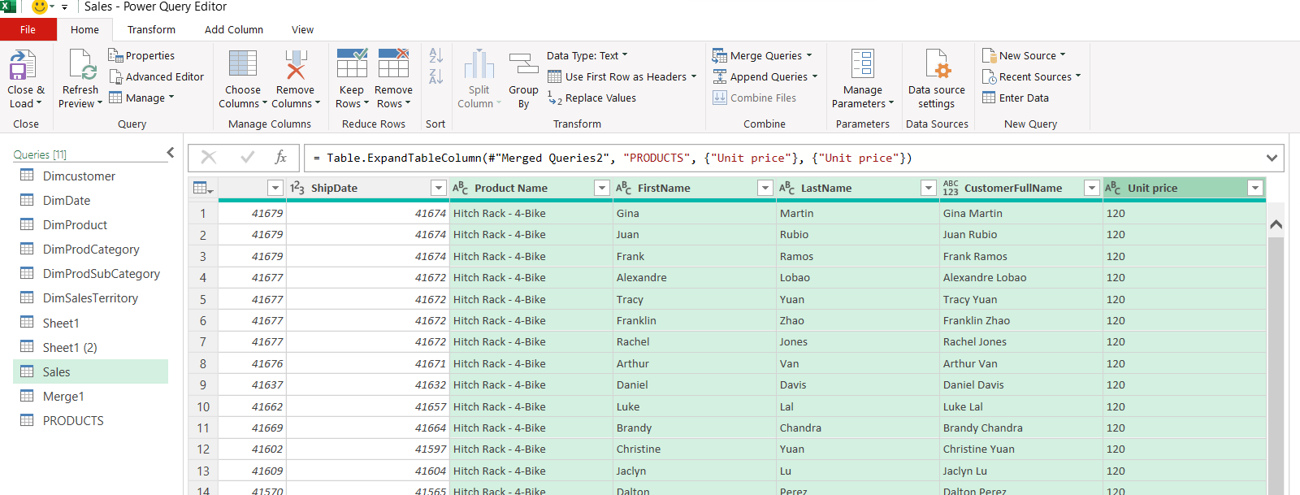
1. Lookup the Productname from the Product sheet to Sales sheet. 2. Lookup the Customerfullname from the Customer Table and Unit Price from Product Table to Sales sheet.
Column added Product Name, CustomerFullName & Unit price

Slide 6
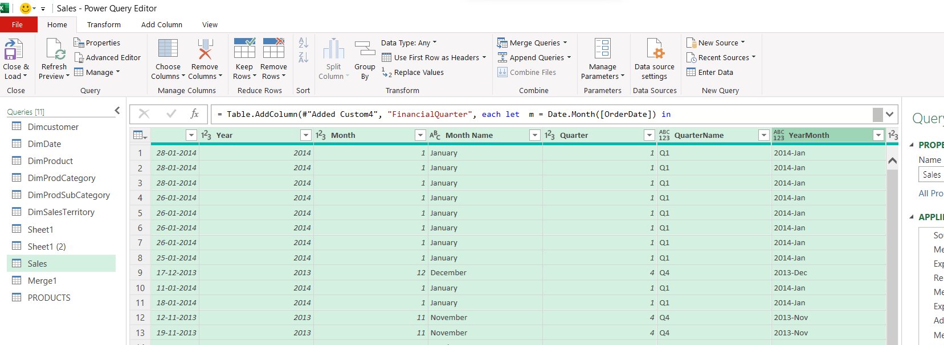
3. Calcuate the following fields from the Orderdatekey field (First Create a Date Field from Orderdatekey) A. Year B. Monthname C. Monthfullname D. Quarter(Q1,Q2,Q3,Q4) E. YearMonth ( YYYY-MMM) F. Weekday Number G. Weekday Name H. Financial Month (** Financial Year starts from April and ends at March - April : 1, May : 2 ….. March : 12) I. Financial Quarter

Slide 7
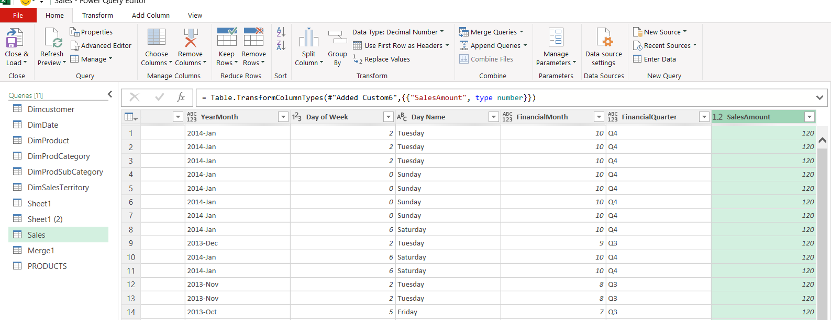
4. Calculate the Sales amount using the columns (Unit price, Order quantity, Unit discount)
Goal:
Create a new column called SalesAmount using the formula:
🔢 Formula: SalesAmount = UnitPrice × OrderQuantity × (1 - UnitDiscountPct)
✅SalesAmount: This column now shows the actual sales revenue after discount.

Slide 8
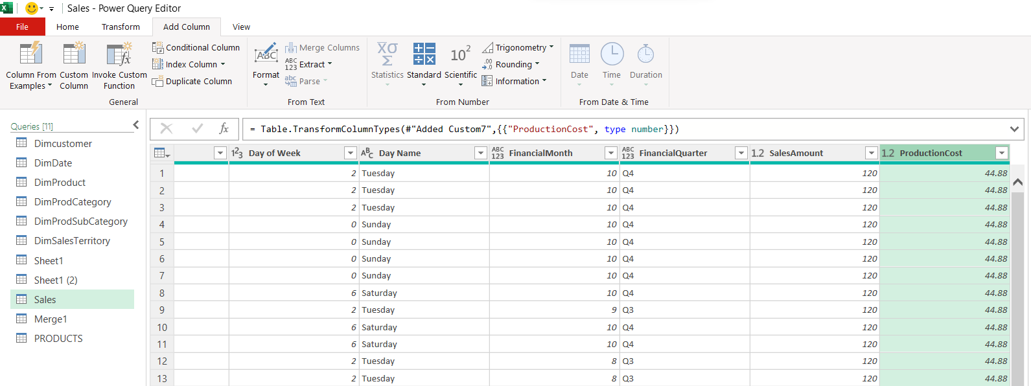
5. Calculate the Productioncost using the columns (Unit cost, Order quantity)
Goal:
Create a new column called ProductionCost using:
🔢 Formula: ProductionCost = ProductStandardCost × OrderQuantity

Slide 9
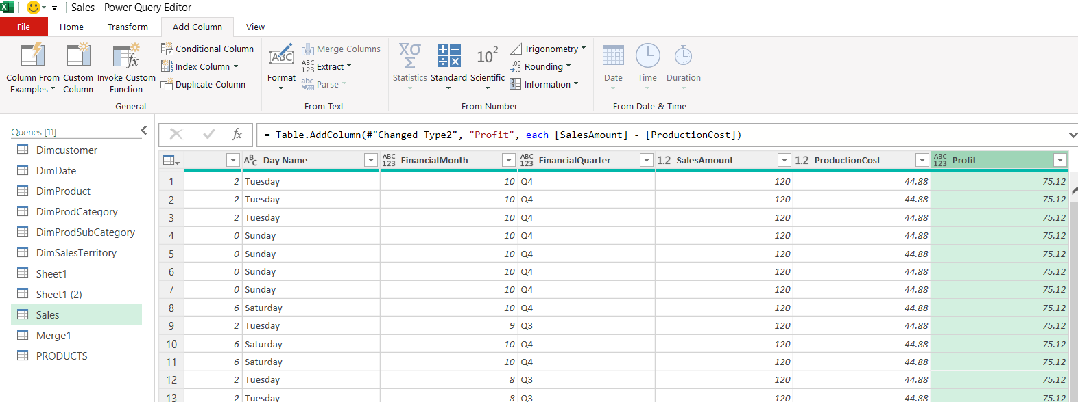
6. Calculate the Profit. (Sales - ProductionCost)
Goal:
Create a new column called Profit using:
🔢 Formula: Profit = SalesAmount - ProductionCost

Slide 10
7. Create a Pivot table for month and sales (provide the Year as filter to select a particular Year)
Pivot Table that shows:
Monthly sales
Filterable by Year

Slide 11
8. Create a Bar chart to show Yearwise Sales
SalesAmount for each Year

Slide 12
9. Create a Line Chart to show Monthwise sales
sales trend across months

Slide 13
10. Create a Pie chart to show Quarterwise sales
sales by quarter

Slide 14
11. Create a Combo chart (bar and Line) to show Salesamount and Productioncost together
A Combo Chart (Bar + Line) to compare Sales and Production Cost over time (e.g., by Month or Year)

Slide 15
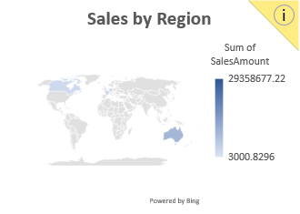
12. Build addtional KPI/Charts for Performance by Products, Customers, Region
KPI visualizations that help answer key questions like:
💼 Which products are top-selling?
👥 Which customers are high-value?
🌍 Which regions perform best in sales?
A. Product Performance
B. Customer Performance
C. Region Performance

Slide 16
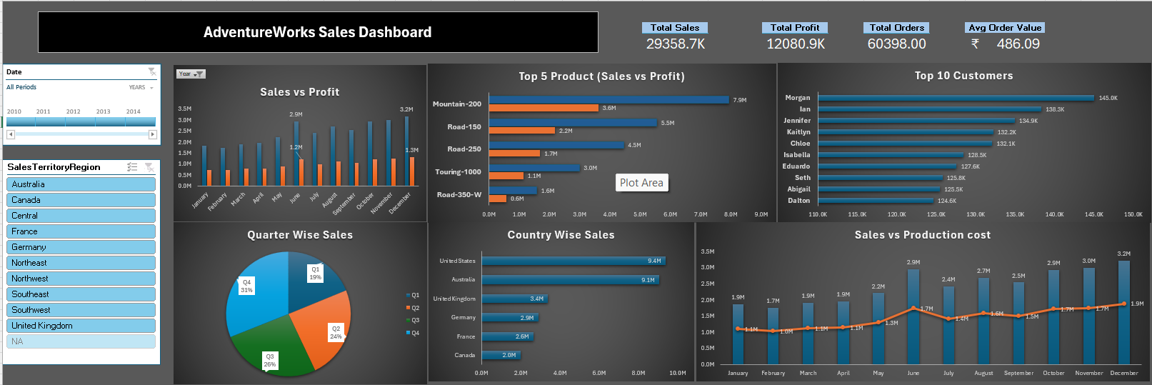
13. Create one or more Dashboards based on the requirement
Dashboard

Slide 17
Key Insights Summary:
Overall Performance
Total Sales: ₹29.36 crores
Total Profit: ₹12.08 crores
Total Orders: 60,398
Average Order Value: ₹486.09 ➤ Indicates a healthy business with strong order volume and profit margin (~41%).
Sales Trends
Sales increased steadily from 2010 to 2013, with a peak in 2013.
Sharp decline in 2014, possibly due to market or internal issues.
Monthly Sales
December has the highest sales (~₹3.2M).
January and February show the lowest sales (~₹1.7M–₹1.9M).
Quarterly Performance
Q4 (Oct–Dec) is the best-performing quarter (31% of total sales).
Q1 (Jan–Mar) is the weakest quarter (19%).
Top Products
Mountain-200 is the top-selling and most profitable product (₹7.9M sales, ₹3.6M profit).
Touring-1000 and Road-350-W are lower-performing in both sales and profit.
Top Customers
Morgan is the top customer (₹145.0K), followed by Ian and Jennifer.
Targeting top 10 customers may improve retention and upselling.
Regional Performance
United States (₹9.4M) and Australia (₹9.1M) are the top-performing countries.
Germany shows high profit contribution.
Canada and Northeast regions perform relatively poorly.
Cost vs Profitability
Sales are consistently higher than production costs, ensuring profitability.
June and December show peak profit months.

Slide 18
Thank you

